Slide 1
Estimating Structures For Use in the Derivation of E_{z}β

Slide 2
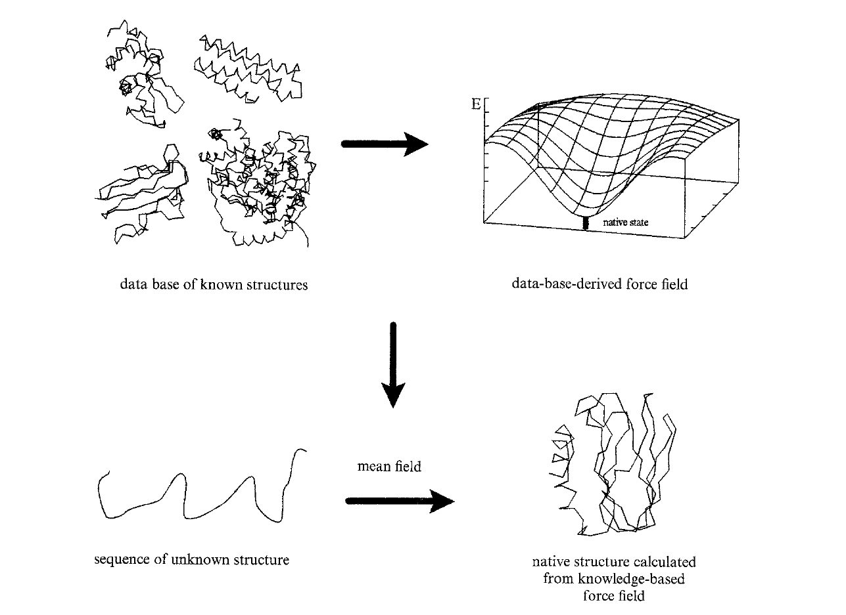
Knowledge-based force fields
“Boltzmann’s principle, knowledge-based mean fields and protein folding”
Manfred J. Sippl, Journal of Computer-Aided Molecular Design, 1993

Slide 3
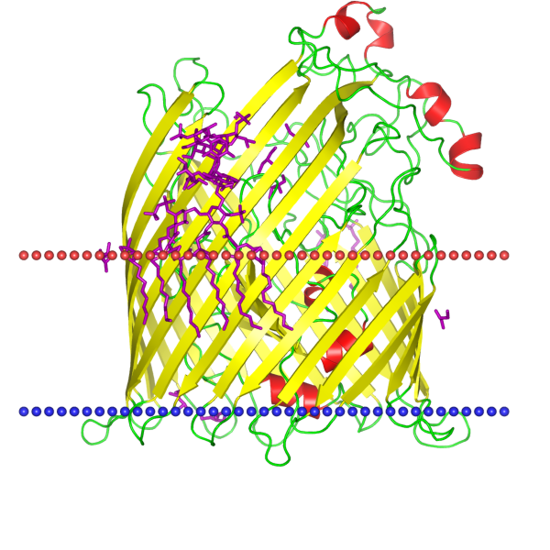
We’re trying to understand insertion, not folding generally
FhuA from Orientations of Proteins
in Membranes database

Slide 4
“The forces encountered in large molecular systems are very complicated. To take full account of their complexity the known macromolecular structures are taken as the only reliable source of information. The goal is to extract the forces and potentials stabilizing native folds in solution from the set of known structures.”
- Manfred Sippl

Slide 5
Less than 1% of structures in the Protein Data Bank are of membrane proteins
We work with about 30 structures
Is that enough?

Slide 6
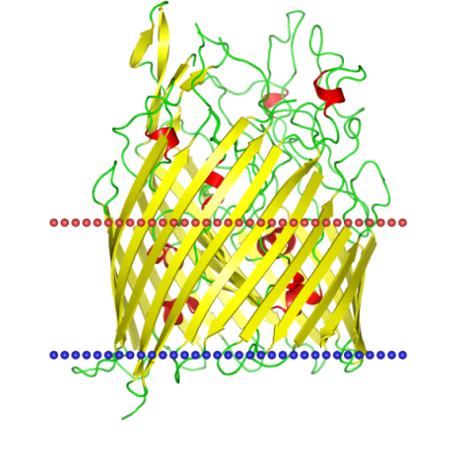
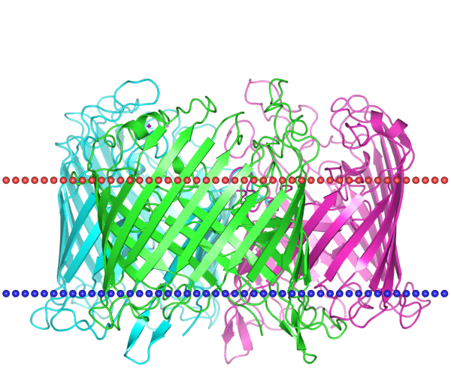
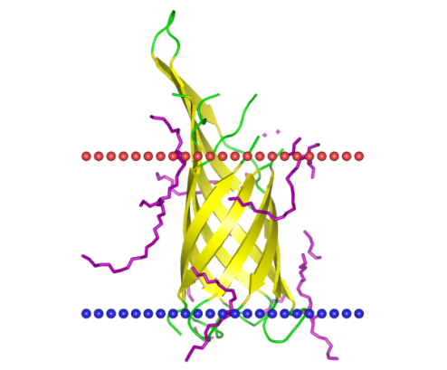
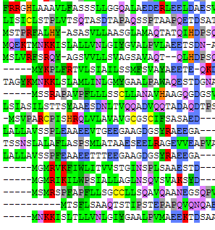
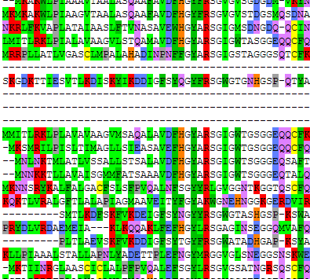
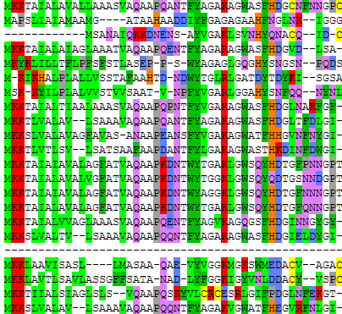
Estimating Structural Information from Sequence

Slide 7
PyMOL break

Slide 8
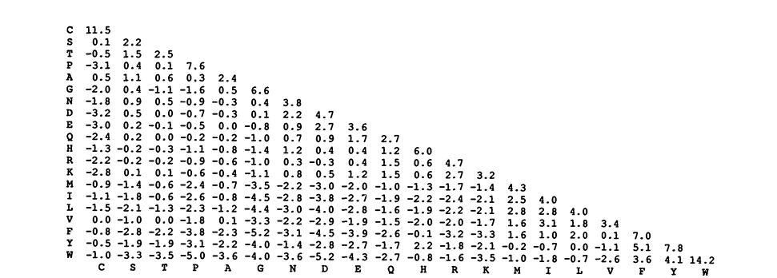
Mutation scoring matrices
“Exhaustive Matching of the Entire Protein Sequence Database”
Gonnet, Cohen, Benner; Science 1992

Slide 9
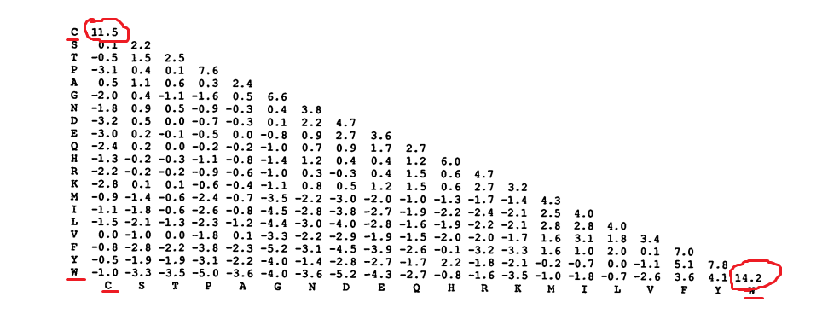
Mutation scoring matrices
“Exhaustive Matching of the Entire Protein Sequence Database”
Gonnet, Cohen, Benner; Science 1992

Slide 10
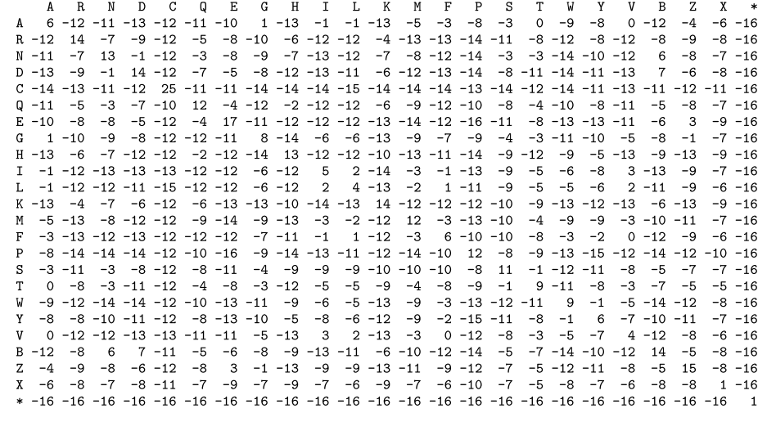
Mutation scoring matrices
“Pattern of Amino Acid Substitutions in Transmembrane Domains of β-Barrel Membrane Proteins for Detecting Remote Homologs in Bacteria and Mitochondria”
Jimenez-Morales, Liang; PLoS One 2011

Slide 11
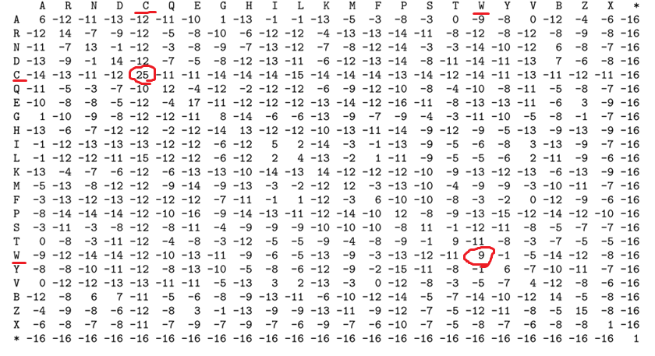
Mutation scoring matrices
“Pattern of Amino Acid Substitutions in Transmembrane Domains of β-Barrel Membrane Proteins for Detecting Remote Homologs in Bacteria and Mitochondria”
Jimenez-Morales, Liang; PLoS One 2011

